Slide 1

ECE 530 Cloud Computing
Ioannis Papapanagiotou
Container Orchestration

Slide 2
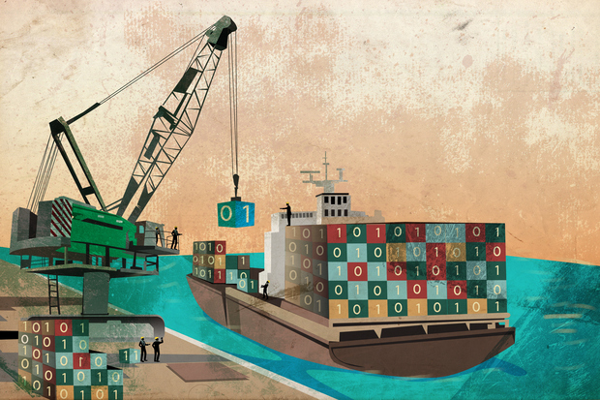
Container Orchestration
Goal: how do we orchestrate billions of containers across perhaps millions of VMs?

Slide 3
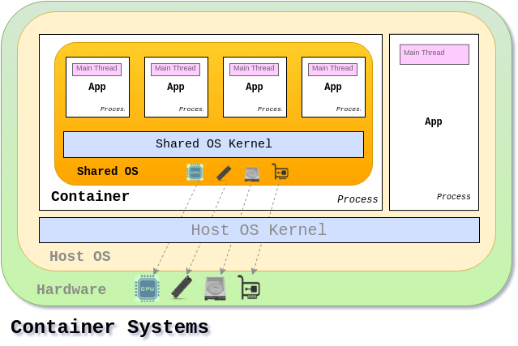
Shared resources
All containers share the same set of resources (CPU, RAM, disk, various kernel things…)
Need fair distribution of goods so everyone gets fair share
Need DoS prevention
Need prioritizations
“All animals are equal, but some animals are more equal than others” – George Orwell

Slide 4
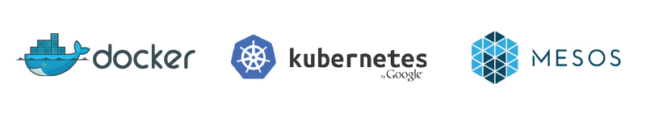
Container Orchestration
Orchestrate containers to facilitate microservices architecture
Provision containers
Manage container dependencies
Enable discovery
Handle container failure
Scale Containers

Slide 5
Which one to choose?

Slide 6
Kubernetes
Kubernetes is based on Google’s experience of many years working with Linux containers.
Some abilities:
Mount persistent volumes that allows to move containers without loosing data,
it has load balancer integrated
it uses Etcd for service discovery.
Kubernetes uses a different CLI, different API and different YAML definitions.
cannot use Docker CLI

Slide 7
Kubernetes: Pods
Pods:
Pods are groups of containers that are deployed and scheduled together.
A pod will typically include 1 to 5 containers which work together to provide a service.
Kubernetes will run other containers to provide logging and monitoring services.
Pods are treated as ephemeral in Kubernetes;
Notes:
In the default Docker networking, containers live on a private subnet and can’t communicate directly with containers on other hosts without forwarding ports on the host or using proxies.
Through using labels, it is easy to do grouping tasks such as assigning pods to load-balanced groups or moving pods between groups.

Slide 8
Kubernetes: Services & Replication Controllers
Services
Services are stable endpoints that can be addressed by name.
Services can be connected to pods by using label selectors; for example my “DB” service may connect to several “C*” pods identified by the label selector “type”: “Cassandra”.
The service will automatically round-robin requests between the pods.
Replication Controllers
Replication controllers are used to instantiate pods in Kubernetes
They control and monitor the number of running pods (called replicas) for a service.
Notes:
Services extra info:
Using services provides a layer of abstraction that means applications do not need to know internal details of the service they are calling; for example application code running inside a pod only needs to know the name and port of the database service to call, it does not care how many pods make up the database, or which pod it talked to last time.
Kubernetes will set up a DNS server for the cluster that watches for new services and allows them to be addressed by name in application code and configuration files.
It is also possible to set up services which do not point to pods but to other preexisting services such as external APIs or databases.

Slide 9
Kubernetes: Net space and Labels
Flat Networking Space:
Containers within a pod share an IP address, but the address space is “flat” across all pods,
all pods can talk to each other without any Network Address Translation (NAT).
This makes multi-host clusters much more easy to manage, at the cost of not supporting links and making single host (or, more accurately, single pod) networking a little more tricky.
As containers in the same pod share an IP, they can communicate by using ports on the localhost address.
Labels:
Labels are key-value pairs attached to objects in Kubernetes, primarily pods, used to describe identifying characteristics of the object
e.g. version: dev and tier: frontend.
Labels are not normally unique; they are expected to identify groups of containers.
Label selectors can then be used to identify objects or groups of objects, for example all the pods in the frontend tier with environment set to production.

Slide 10
Docker Swarm
A native clustering for Docker.
Exposes standard Docker API
meaning that any tool that you used to communicate with Docker (Docker CLI, Docker Compose, Dokku, Krane, and so on) can work equally well with Docker Swarm.
Bound by the limitations of Docker API

Slide 11
Docker Swarm: Architecture
Architecture:
each host runs a Swarm agent and one host runs a Swarm manager (on small test clusters this host may also run an agent).
The manager is responsible for the orchestration and scheduling of containers on the hosts.
Swarm can be run in a high-availability mode where one of etcd, Consul or ZooKeeper is used to handle fail-over to a back-up manager.
There are several different methods for how hosts are found and added to a cluster, which is known as discovery in Swarm.
By default, token based discovery is used, where the addresses of hosts are kept in a list stored on the Docker Hub.

